Slide 1


Slide 2

Notes:
Firebug student discount is all week and not just when we go out as a society

Slide 3


Slide 4

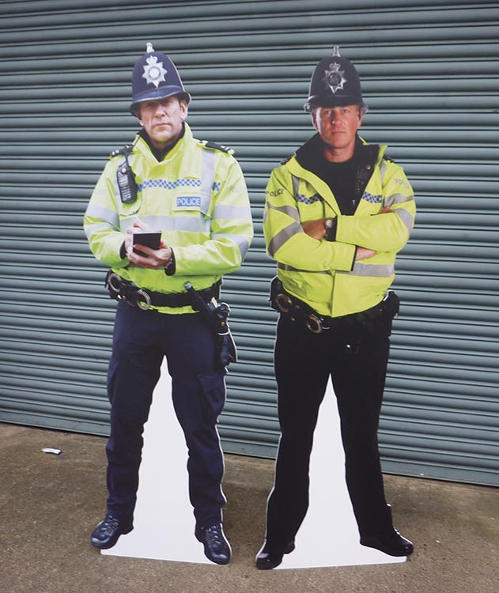




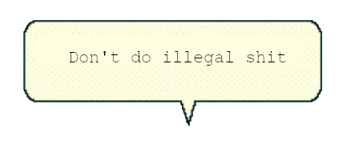

D0n’t D0 ill3gal Sh1t !
Notes:
BonziBuddy

Slide 5
Reverse Engineering
The process of taking some software and analysing its functions and flow to understand its function and behaviour.
This is not something that is only done within Cyber Security but it does play a big role.

Slide 6
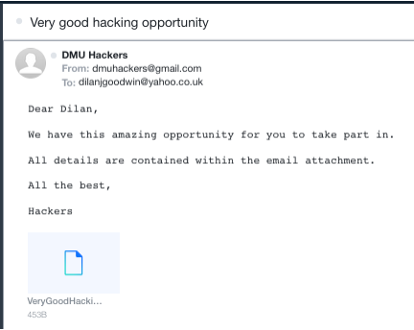
Scenario
“Email with a strange looking download”
Notes:
Why is reverse engineering useful

Slide 7
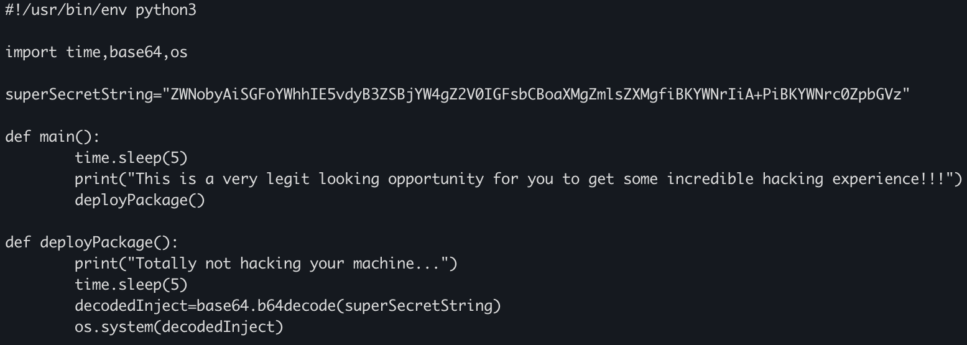
Scenario
Taking a closer look at the file:
Notes:
Well I definitely do not like the look of that superSecretString
The program does tell us that it is base64 though which makes this easy

Slide 8

Scenario
What is that string?
ZWNobyAiSGFoYWhhIE5vdyB3ZSBjYW4gZ2V0IGFsbCBoaXMgZmlsZXMgfiBKYWNrIiA+PiBKYWNrc0ZpbGVz
Decode Base64
echo "Hahaha Now we can get all his files ~ Jack" >> JacksFiles
Notes:
Looks like Jack was after my files again,

Slide 9
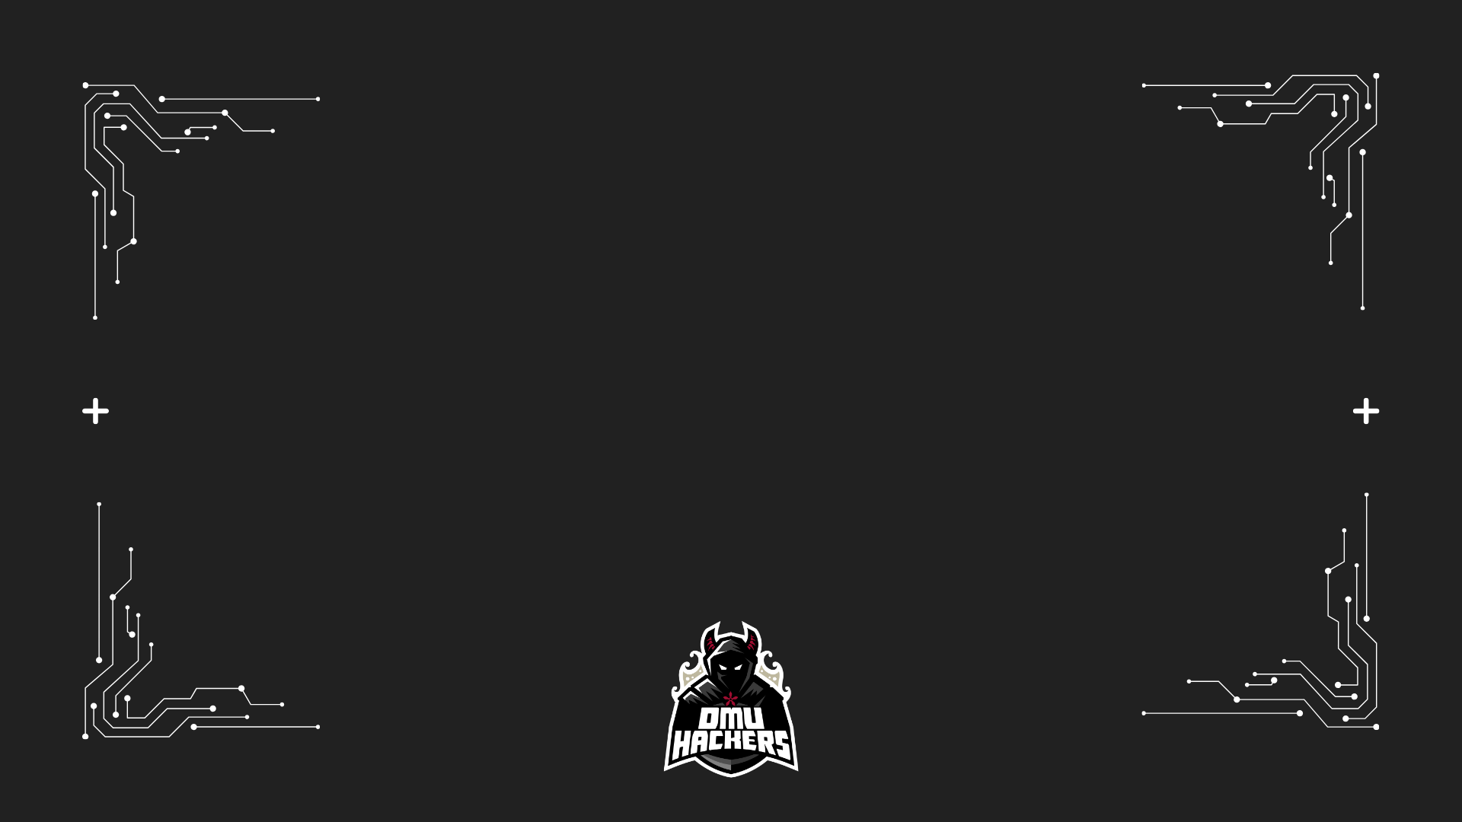
Tools
When it comes to reverse engineering the tools that you use are very dependent on the format of the files in question.
For something like powershell, bash and python you can just use a text editor but for compiled programs you might want something a bit more robust.

Slide 10


Ghidra
Open source software tool developed by the NSA and is free to download from their GitHub.
The application reverses executable (assembly) into C code, it is also able to analyse the code to pull out functions, classes and more.

Slide 11
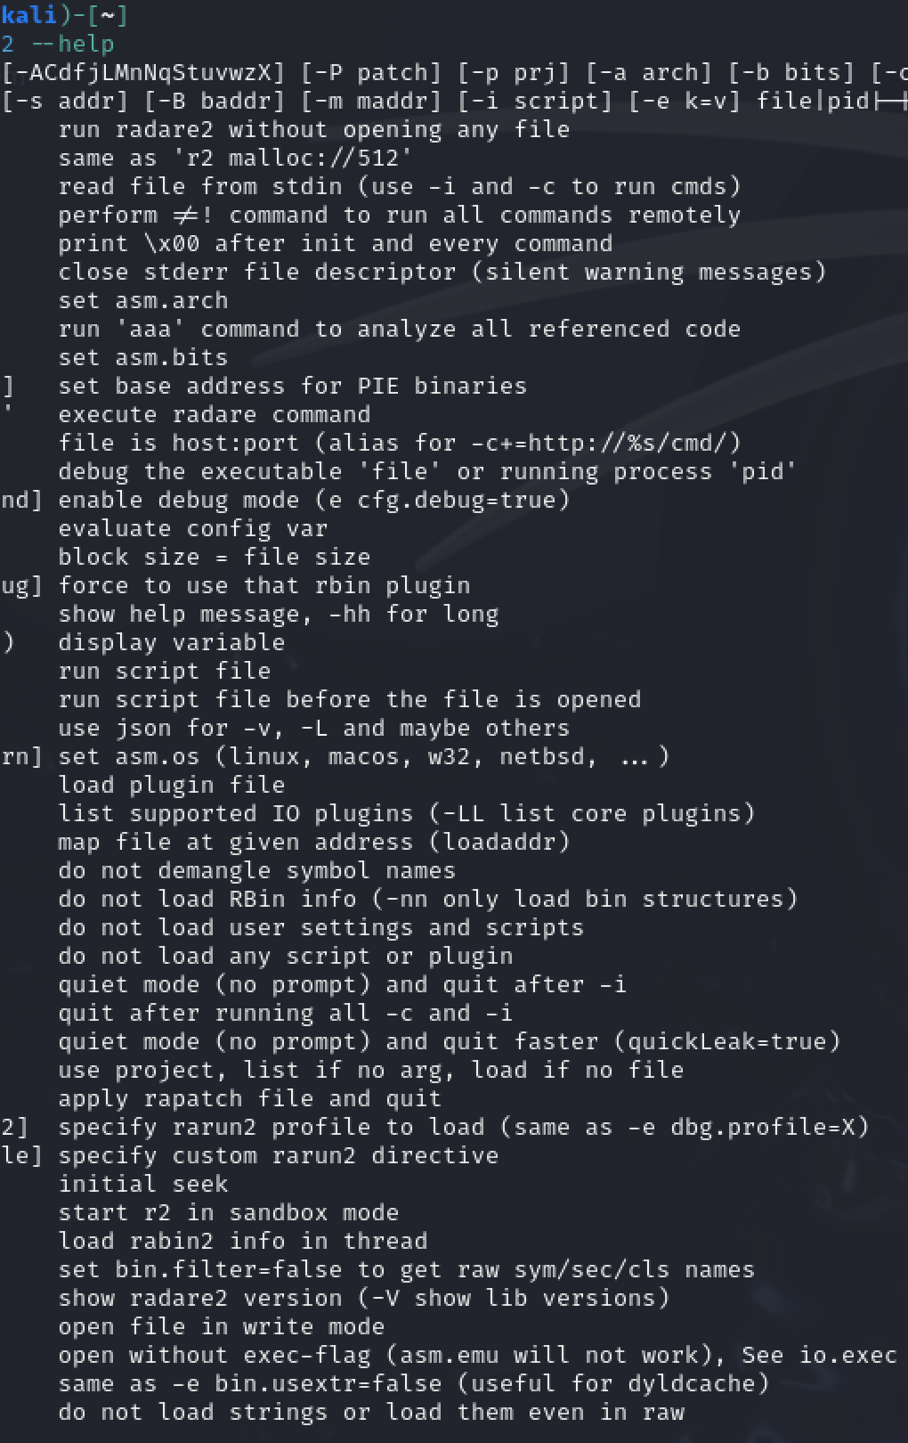

Radare2
Framework for reverse engineering and binary analysis from the terminal.
There is even a scripting language for it (based off python) and a GUI that you can get separately.

Slide 12
Live Example
Notes:
Using one of the HTB Practice CTF examples

Slide 13



Your turn!
https://tryhackme.com/jr/dmuhackersrev

